Slide 1
System Development Methods CT00046-3-2
System Development Planning
Part 1

Slide 2
Topic & Structure of the Lesson
Initial Study
Feasibility Study
Resource Planning
Outsourcing

Slide 3
Learning Outcome
At the end of the module, you should able to:
Explain the initial process of a software development project planning.
Use planning to tools to estimate resources.

Slide 4
Key Terms you must be able to use
If you have mastered this topic, you should be able to use the following terms correctly in your assignments and exams:
Initial Study
Feasibility Study
Resource planning tools
Outsourcing options

Slide 5
IS Planning Strategies
Problems Statement
Initial Study
Feasibility Study
Requirements Engineering
Resource Planning
Costing and Scheduling
Outsourcing Options

Slide 6
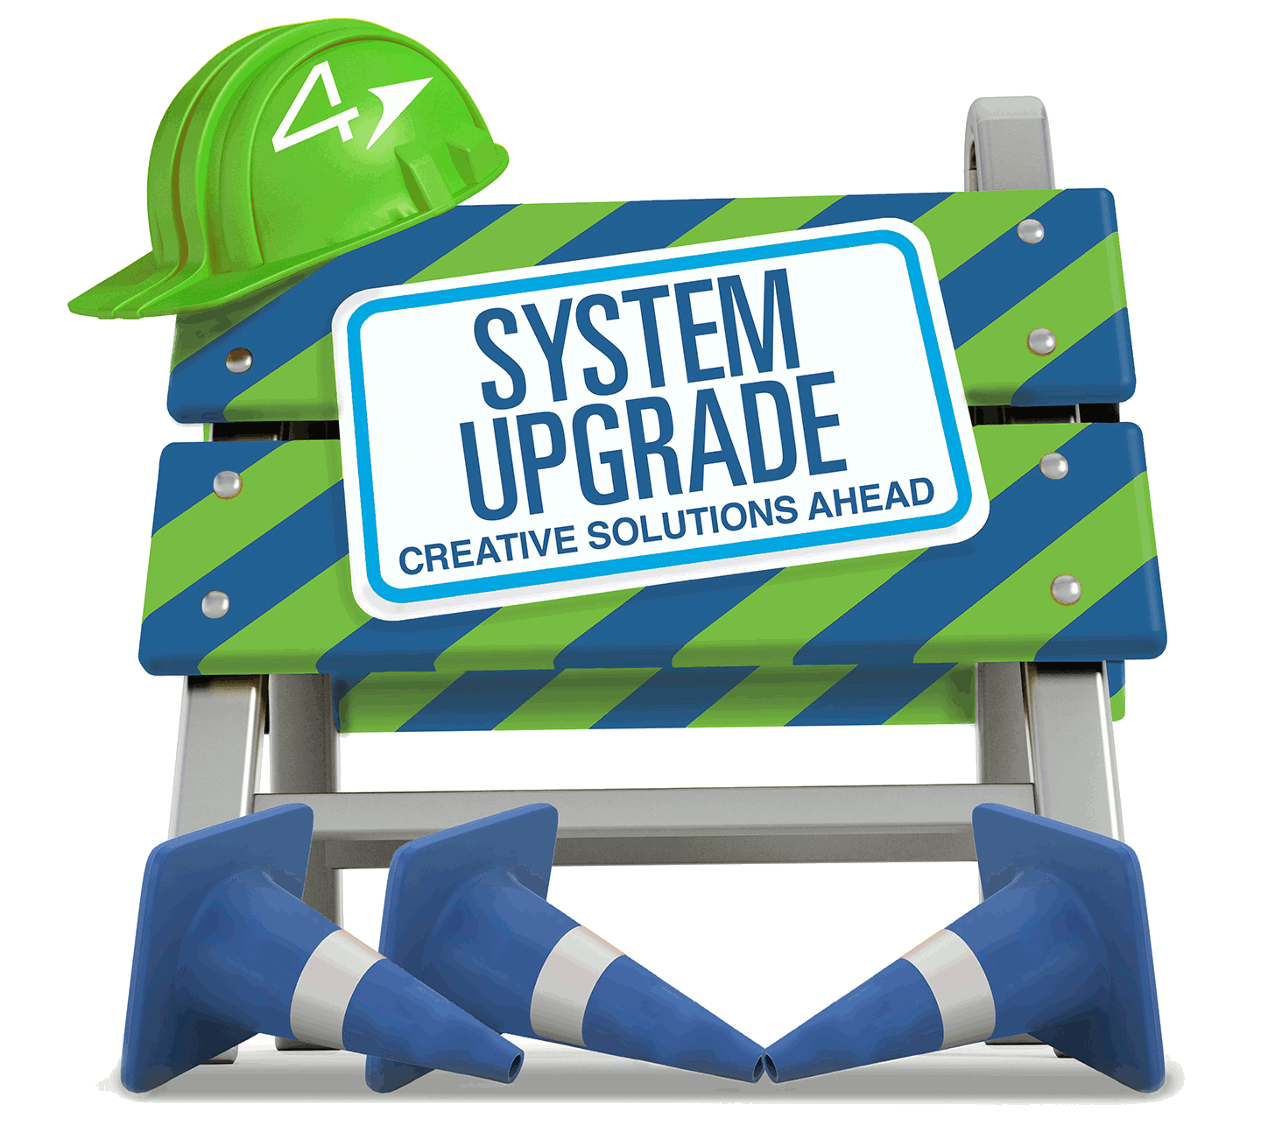
Problem Statement
Every new projects starts to solve some type of ‘problem’ with a ‘current process’.
Defect to the old system
Bugs, user complaints, unable to support current increasing demand, etc.
Opportunity or need for upgrade
directive, competition, available budget, available new technology, etc.
‘problems’ usually reported by users / customers using the old/existing system.

Slide 7

Initial Study Process
Conducted by expert / consultant on the existing (old) system
System Analyst, System Engineers
Study ‘Problem Statement’
Verify problem which are reported to the existing system.
Find the source / cause of the problem
Narrow down solutions to solve problem.
Come up with solutions.
Options – to upgrade, replace, etc.
Create Project Proposal.
Present suggested solution to customer / business owner

Slide 8
Quick Quiz
What does a Project Proposal contain?

Slide 9

Feasibility Study
Conducted by potential developer
Project owner hires Developer
IN-HOUSE developers or
VENDORS hired through project tendering process.
Developer conducts FEASIBILITY STUDY to see if the project can be done according to owner’s requirements.
Output – Feasibility Study Report

Slide 10

Common types of Feasibility Study
Technical feasibility
Schedule feasibility
Economic feasibility
Operational feasibility
Legal feasibility
Cultural feasibility, etc

Slide 11
The importance of Feasibility Study
When to do FS?
Before starting a project.
When the main requirements are clear.
When are all projects feasible ?
When most of the facts analysed had a positive outcome, such as profit, benefits, solutions, etc.
What happens when the FS fails (negative outcome)?
The project maybe suspended / scrapped.
Vendors might not take up the project.

Slide 12
Quick Quiz
What are the objectives of doing Feasibility Study?
Who would be involved in a Feasibility Study for a new website at APU?

Slide 13
Resource Planning Quick Quiz
What are the ‘resources’ in a typical IT Project?

Slide 14

Resource Planning
Resource Planning is important, especially to estimate time and cost of the project
Normally done at the early stage of planning, with clear requirements
Involves activities;
Define scope
Human resource planning
Resource costing
Resource scheduling and job delegation
Equipment planning – Hardware, software, etc
Resource RISK Planning

Slide 15

Resource Planning … cont
Tools used for Resource Planning
PERT Chart & Gantt Chart – For project activities and human resources planning
Work Break-down Structure - For tasks and multiple resources assigned to each.
Hierarchy Task Analysis - For task restructuring

Slide 16
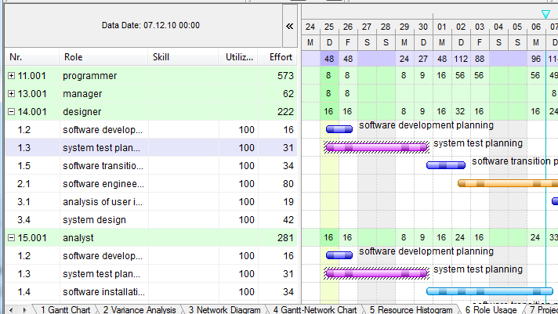
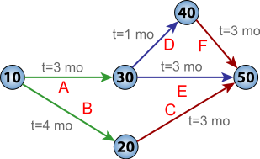
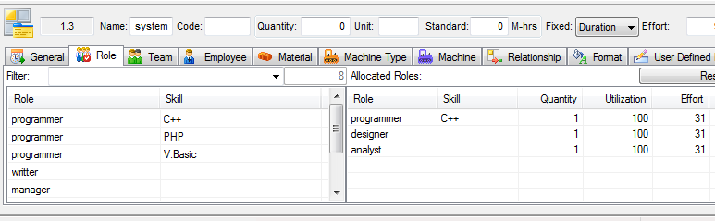
Resource Planning PERT Chart & Gantt Chart

Slide 17
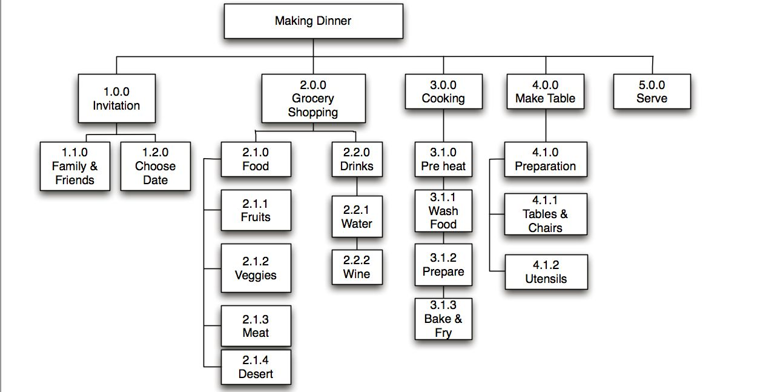
Resource Planning Work Breakdown Structure (WBS)

Slide 18
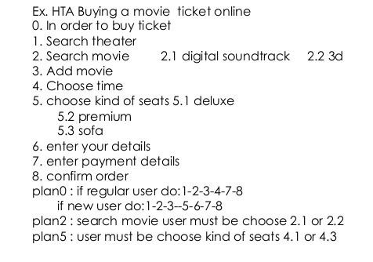
Resource Planning Hierarchy Task Analysis

Slide 19
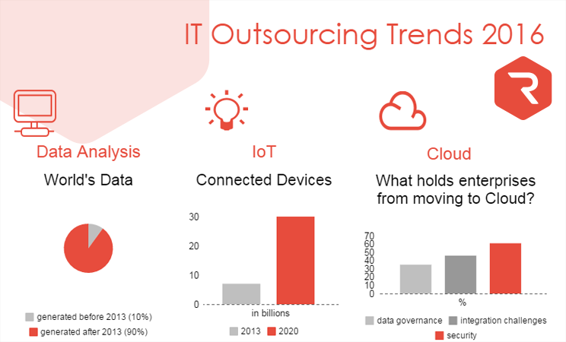
Outsourcing
IT outsourcing is the use of external service providers to effectively deliver IT-enabled business process, application service and infrastructure solutions for business outcomes.

Slide 20
Outsourcing reasons and objectives
Company lack resources (Hardware, software, staff, etc.) to handle some tasks.
Company don’t have the expertise to handle the task.
Company’s wants to concentrate on main business, so outsourced less important tasks.
Company wants to transfer risk – vendors absorb the risks and provide warranty.
Cost Saving – off-shore outsourcing is often cheaper then running the task locally.

Slide 21
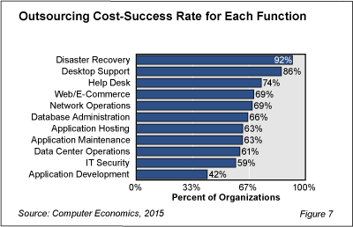
Outsourcing problems
Outsourcing to experts could be expensive.
Security risk – outsourcing critical systems.
Loss of control - Owner don’t own the system entirely, risk depending on vendor.

Slide 22
Question & Answer

Slide 23
Next Session
System Development Planning – Part 2

Slide 24
Tutorial
What are the contents of a Feasibility Study Report?
What are the information that you can get from a Gantt Chart?
Name THREE services which are outsourced by company’s today and why.
You are involved in creating a website for APU. Create a Work Breakdown Structure (WBS) for the project. Include at least 3 main task and 3 sub-tasks for each.

